Slide 1
Avanade DevOps Practitioner
Creating fast and continuous feedback

Slide 2



Expectations During Sessions
Share your experience and ask questions
Participate in the activities
Stay Engaged

Slide 3
Review Questions & Answer Activity
~15 minutes
Review open questions or comments captured in the project, or from the attendees today.
Notes:
We have been short on time at the end of each session so I figured we would open at the start today with a little Q&A.
Questions - All - Boards (azure.com)
https://docs.microsoft.com/en-us/azure/devops/test/run-automated-tests-from-test-hub?view=azure-devops

Slide 4
Avanade DevOps Practitioner Sessions
Sessions
1 | Pre-work overview
2 | Using Azure DevOps Services, Security in DevOps
3 | Practice to create fast flow
4 | Practices to create fast and continuous feedback
5 | Practices of experimentation and continuous learning
6 | Azure security and compliance
Session Agenda
Engineering Feedback, Application Logs, Application Insights, Performance efficiency, Performance excellence, Monitor logs

Slide 5
Learning Objectives Activity
8 minutes
Update status on learning objectives and follow up with associated questions.
Notes:
https://dev.azure.com/ava-continuous-learning/DevOps%20Practitioner%20NA/_queries/query/b52283c4-2f71-4cd3-b90d-47271e1c6ad5/
Demonstrate State Change
Adding supporting questions
We are going to take five minutes at the start of this session to reflect on our learning objectives. I would like each you have to take these first five minutes and refine what you have entered at the start of the course. Please note that we have gone through and added tags to your learning objectives to group them. As part of this refinement activity, we would like you to check the title, add a description, and start putting in an acceptance criteria that describes to your best ability what you needs to be covered to satisfy that learning objective.
Also, if you have new objectives please add them, and last if we have covered or actively covering your learning objective, please update the status.

Slide 6

Simpler Way to Create Service Principle
Quick demo of easier way to create a service principle.
az ad sp create-for-rbac --name "azuredevops-sp-quickdemo" --sdk-auth --role contributor --scopes /subscriptions/{sub-id}
Notes:
az ad sp create-for-rbac --name "azuredevops-sp-quickdemo" --sdk-auth --role contributor --scopes /subscriptions/{47dd0713-55df-415d-8b71-33235027e415}

Slide 7
Session 4 (2.5 hrs)
Practice to create fast and continuous feedback
Pattern and Practice of Feedback
Local unit testing, pull requests, remote unit testing, static analysis
Capture Web Application Logs with App Service Diagnostics Logging
Capture and view page load times in your Azure web app with Application Insights
Instrument server-side web application code with Application Insights
Analyze your Azure infrastructure by using Azure Monitor logs
Capturing Custom Events from Application Logs
Notes:
References:
https://docs.microsoft.com/en-us/learn/paths/az-400-develop-instrumentation-strategy/
https://docs.microsoft.com/en-us/learn/modules/capture-application-logs-app-service/
https://docs.microsoft.com/en-us/learn/modules/instrument-web-app-code-with-application-insights/
https://docs.microsoft.com/en-us/learn/modules/capture-page-load-times-application-insights/
https://docs.microsoft.com/en-us/learn/modules/azure-well-architected-performance-efficiency/
https://docs.microsoft.com/en-us/learn/modules/analyze-infrastructure-with-azure-monitor-logs/

Slide 8
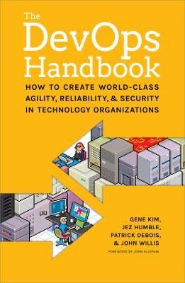
The Practices of Feedback
Flow
Feedback
Experimentation
Dev
Dev
Ops
Dev
Ops
Ops
Practices to create Fast and Continuous Feedback

Slide 9
Continuous Integration – Typical feedback
Automate and Enable Low-Risk Releases
Developer /
Pre-Commit
Version Control /
Pull Request
Build and Unit Testing
Automated Acceptance Testing
User (manual) Acceptance Testing
Release
(Production)
Push/ Check-in
1
2
Trigger
Feedback
3
Update
4

Slide 10
Continuous Delivery – Typical feedback
Automate and Enable Low-Risk Releases
Developer /
Pre-Commit
Version Control /
Pull Request
Build and Unit Testing
Automated Acceptance Testing
User (manual) Acceptance Testing
Release
(Production)
Push/ Check-in
1
2
Trigger
Feedback
3
Update
4
Trigger
5
Feedback
Approval
6
7

Slide 11
Continuous Deployment – Typical feedback
Automate and Enable Low-Risk Releases
Developer /
Pre-Commit
Version Control /
Pull Request
Build and Unit Testing
Automated Acceptance Testing
User (manual) Acceptance Testing
Release
(Production)
Push/ Check-in
Trigger
Feedback
Feedback
Trigger
Feedback
Approval
Approval
Notes:
Manual Acceptance testing may be required for items that are not yet automated. These become bottlenecks to continuous deployment.

Slide 12
Run quality tests in build pipeline (unit test)
Demo
Open SmartHotel360 in Visual Studio. See and run 3-unit tests.
Open Azure Pipeline
See Run Unit Tests task
Watch Pipeline Run the tests
Open pipeline summary. Tests tab to see a summary of the test run
Test Plan --> Runs
Go into most recent test run and see the summary of results
Notes:
References: https://docs.microsoft.com/en-us/learn/modules/run-quality-tests-build-pipeline/

Slide 13
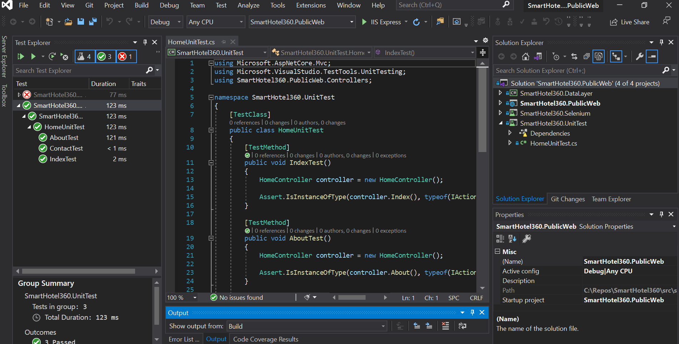

Slide 14
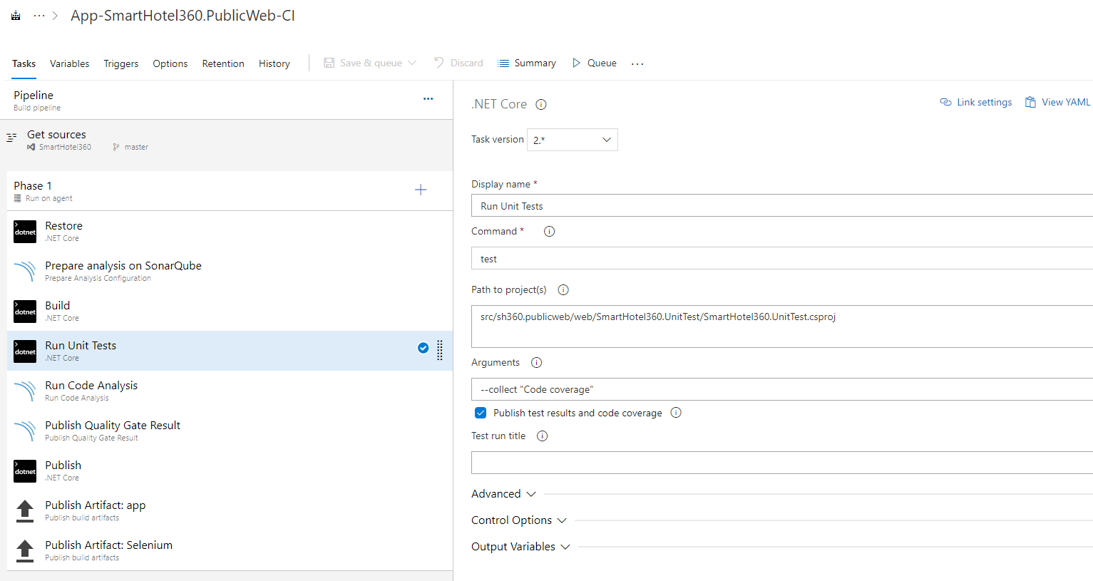

Slide 15
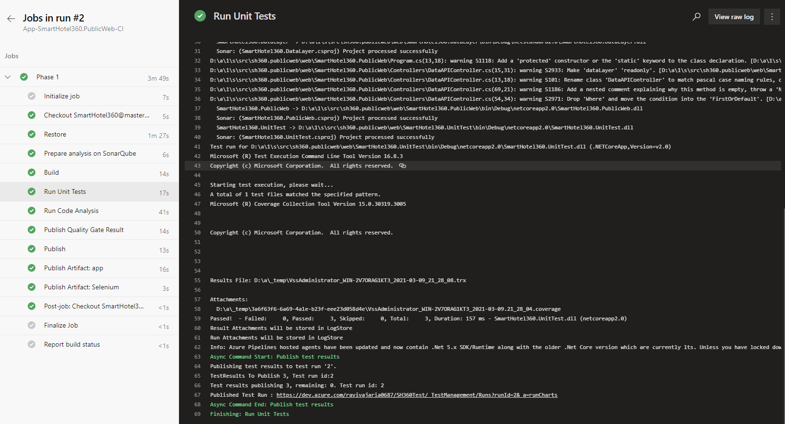

Slide 16
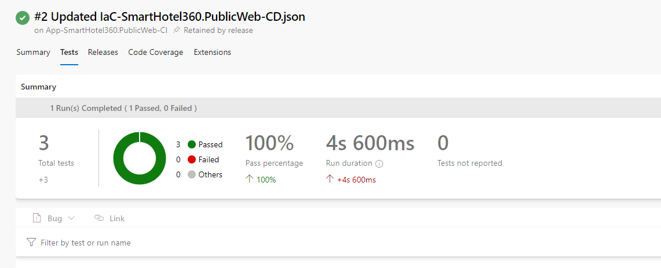

Slide 17
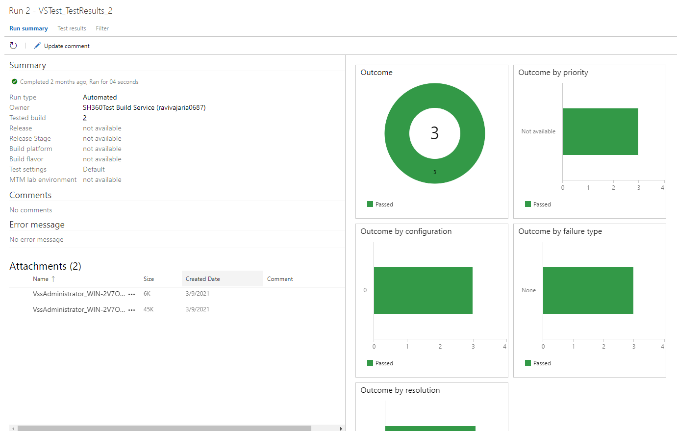

Slide 18
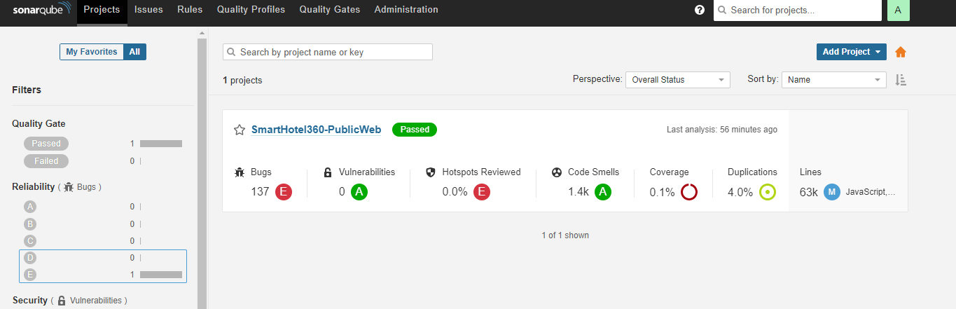
Run quality tests in build pipeline (SonarQube)
Demo
Open SonarQube Web App on Azure
View code analysis result in SonarQube

Slide 19
Business Significant Metrics
Deployment Frequency | Change Volume | Lead Time (From Dev to Deploy)
% of Failed Deployments | Mean Time to Recovery | Customer Ticket Volume
% Change in User Volume | Availability | Performance (Response Time)
Using Continuous Feedback to help visualize the flow of value.
Last week: 10
This week: 12
Last week: 310 LOC
This week: 301 LOC
Last week: 4 weeks
This week: 3.5 weeks
Last week: 20%
This week: 33.33%
Last week: 20 min/issue
This week: 12 min/issue
Last week: 78
This week: 96
Last week: 4.5K
This week: 4.6K
Last week: 99.5%
This week: 99.36%
Last week: 3.5 sec
This week: 3.5 sec
Notes:
References: https://docs.microsoft.com/en-us/learn/modules/run-functional-tests-azure-pipelines/

Slide 20
Run functional & non-functional tests in Pipelines
Helps automate tests that needs to be run after a service is operational and deployed to an environment
Functional tests verify application’s behavior – does it do what it should?
Non-functional tests check characteristics like performance and reliability
Notes:
References: https://docs.microsoft.com/en-us/learn/modules/run-functional-tests-azure-pipelines/
https://avanade.sharepoint.com/sites/QAAcademy

Slide 21
Kinds of functional tests (1/2)
Commonly used functional tests | Purpose | Example
Unit testing | Verify individual function or method. | Test to verify function performing calculation based on user entry. The UI tests that you'll run later in this module are unit tests.
Smoke testing | Verify most basic functionality. | Use curl to verify that the site is reachable and that fetching the home page produces a 200 (OK) HTTP status.
Integration testing | Verify that multiple components work together. | Test that adds items to the shopping cart and then purchases the items to verify that the web application can connect to the products database and then fulfill the order.
Regression testing | Verify that a new feature or bug fix doesn't break existing functionality. While automating, regression testing might involve just running all unit tests and integration tests each time the software changes. | While optimizing a database for write performance, run regression test to know how read performance is impacted.
Notes:
References: https://docs.microsoft.com/en-us/learn/modules/run-functional-tests-azure-pipelines/

Slide 22
Kinds of functional tests (2/2)
Commonly used functional tests | Purpose | Example
Sanity testing | Test each major component of a piece of software to verify that the software appears to be working and can undergo more thorough testing. Can be automated, but it's often done manually in response to a feature change or a bug fix. | While validating a bug fix, also verify that other features are working by entering some typical values. If the functionality appears to be working as expected, it can then go through a more thorough test pass.
User interface testing | Verify that the sequence, or order, of user interactions leads to the expected result for various platforms and devices. | A UI test might verify that the correct animation appears in response to a button click. A second test might verify that the same animation appears correctly when the window is resized.
Usability testing | A form of manual testing to verify that the software is intuitive and meets the user's needs. Typically done by the team that builds the software. | A website might include a link to the user's profile. A UI test can verify that the link is present and that it brings up the user's profile when the link is clicked. However, if humans can't easily locate this link, they might become frustrated when they try to access their profile.
User acceptance testing (UAT) | Like usability testing but more scripted. Typically done by real end users.
Notes:
References: https://docs.microsoft.com/en-us/learn/modules/run-functional-tests-azure-pipelines/

Slide 23
Run functional tests in Pipelines
In Pipelines, we run functional tests just like you run any other process or test. Decide the following:
In which stage will the tests run? (e.g., Test / Staging / UAT)
On what system will the tests run? Will they run on the agent or on the infrastructure that hosts the application?
Next, we will explore incorporating Selenium UI tests into the pipeline
Notes:
References:
https://docs.microsoft.com/en-us/learn/modules/run-functional-tests-azure-pipelines/2-what-is-functional-testing
https://docs.microsoft.com/en-us/learn/modules/run-functional-tests-azure-pipelines/4-plan-ui-tests

Slide 24
Run functional tests in Pipelines – Plan the UI tests
First off, have the user's perspective in mind – there is no way to automate that ☺
Good starting point is to automate something we regularly do manually. Pick a UI test, walk through it and write down the steps. Next, figure out how to automate those steps.
Notes:
References:
https://docs.microsoft.com/en-us/learn/modules/run-functional-tests-azure-pipelines/4-plan-ui-tests

Slide 25
Run functional tests in Pipelines - Demo
Demo to automate the UI test of finding a room in New York.
Manual test steps:
Browse to the Web App
Click Login
Scroll down and Click “Where”. Enter “New”. Select “New York”
Enter dates. Apply. Click FIND A ROOM.
View the list. Select a room to view.
Automated test - run using Visual Studio
Automated test - run in Pipeline

Slide 26
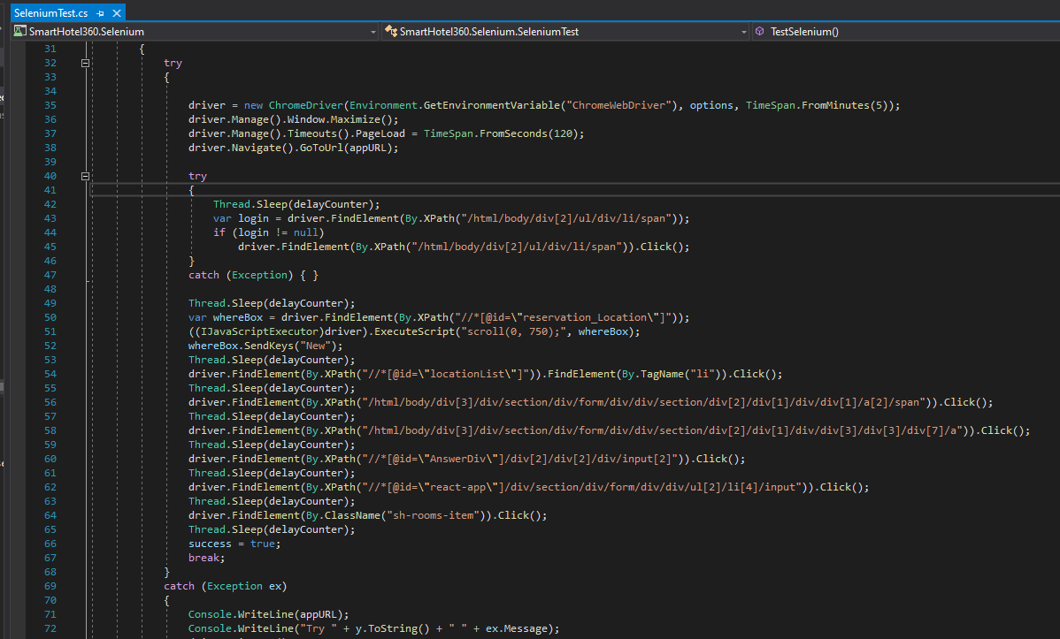
Run functional tests in Azure Pipelines – Demo
Automate the UI test of finding a room in New York.
Automated test - run
in Visual Studio.
appURL in config.runsettings file Configure unit tests with a .runsettings file - Visual Studio | Microsoft Docs
Test → Configure Run Settings OR
Tools → Options → Test
View code
Run Test from Visual Studio
Notes:
References:
https://docs.microsoft.com/en-us/learn/modules/run-functional-tests-azure-pipelines/4-plan-ui-tests
https://docs.microsoft.com/en-us/visualstudio/test/configure-unit-tests-by-using-a-dot-runsettings-file?view=vs-2019
To be able to run Selenium tests locally:
download the driver https://chromedriver.chromium.org/downloads
save ChromeDriver.exe at same location as Chrome.exe
add C:\Program Files\Google\Chrome\Application to PATH environment variable.
Then this should work: driver = new ChromeDriver();

Slide 27
Run functional tests in Azure Pipelines – Demo
To be able to run Selenium tests locally:
Download the driver https://chromedriver.chromium.org/downloads
Save ChromeDriver.exe at same location as Chrome.exe
Add C:\Program Files\Google\Chrome\Application to PATH environment variable.
Notes:
References:
https://docs.microsoft.com/en-us/learn/modules/run-functional-tests-azure-pipelines/4-plan-ui-tests
https://docs.microsoft.com/en-us/visualstudio/test/configure-unit-tests-by-using-a-dot-runsettings-file?view=vs-2019
To be able to run Selenium tests locally:
download the driver https://chromedriver.chromium.org/downloads
save ChromeDriver.exe at same location as Chrome.exe
add C:\Program Files\Google\Chrome\Application to PATH environment variable.
Then this should work: driver = new ChromeDriver();

Slide 28
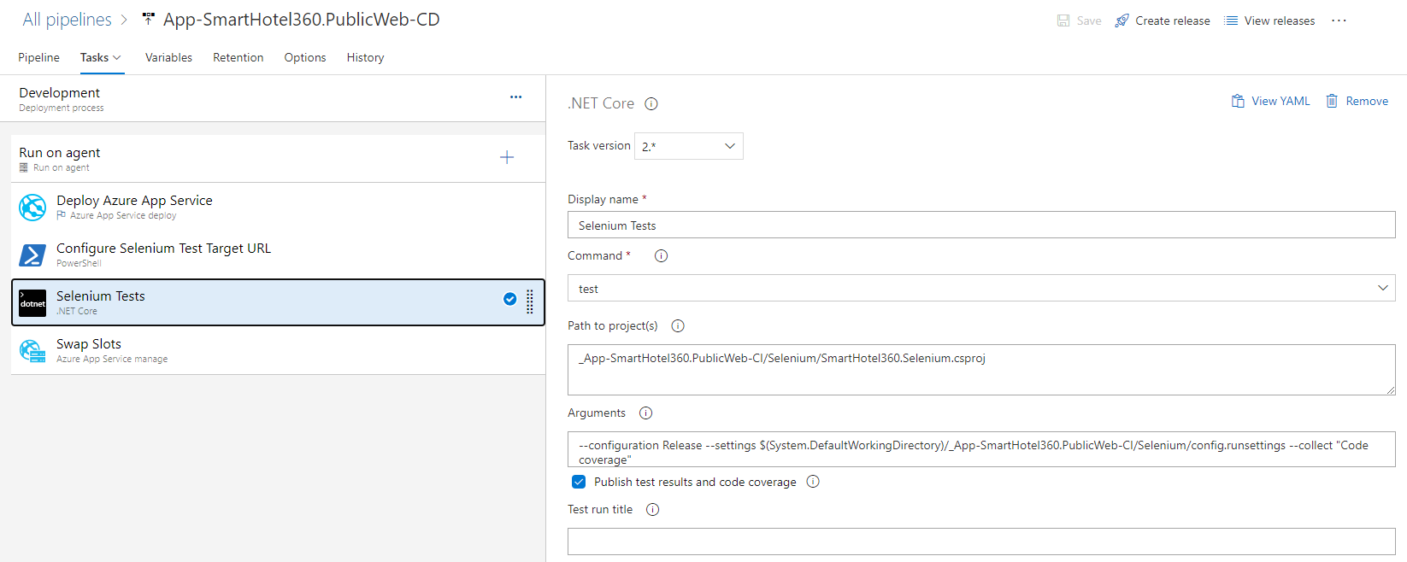
Run functional tests in Azure Pipelines – Demo
Automate the UI test of finding a room in New York.
Automated UI Test in Azure Pipeline.

Slide 29
Run non-functional tests in Pipelines
How do nonfunctional tests compare to functional tests?
Functional tests verify that each function of the software does what it should. i.e., verify functionality
Nonfunctional tests check other aspects of an application such as performance and reliability
Also applicable for systems that aren't apps, such as infrastructure components.
One example of a nonfunctional test is to determine how many people can simultaneously sign in to an application without causing a problem, such as slower response times.
Notes:
References: https://docs.microsoft.com/en-us/learn/modules/run-non-functional-tests-azure-pipelines/
Non-functional tests check for the “ities”

Slide 30
Run non-functional tests in Pipelines
Nonfunctional testing always tests something that's measurable
The goal is to improve the product
That can be done by
Improving how efficiently the application uses resources OR
Improving response times when many customers use it simultaneously.
Here are some of the questions that nonfunctional tests can answer:
How does the application perform under normal circumstances?
How does the application perform when many users sign in concurrently?
How secure is the application?
Notes:
References: https://docs.microsoft.com/en-us/learn/modules/run-non-functional-tests-azure-pipelines/

Slide 31
Run non-functional tests in Pipelines
Kinds of nonfunctional tests
Performance testing
Load testing
Stress testing
Security testing
Penetration testing (aka pen testing)
Compliance testing
Notes:
References: https://docs.microsoft.com/en-us/learn/modules/run-non-functional-tests-azure-pipelines/

Slide 32
Run non-functional tests in Pipelines – Performance testing
Two common types of performance tests are load tests and stress tests
Load tests
Determine the performance of an application under realistic loads - upper limit might be defined by service-level agreement (SLA)
Use load tests to uncover issues such as buffer overflow or memory leak that occur only when app is operating at its limits
Stress tests
Determine stability of app when load goes beyond defined limit. Will it crash? If so, check to ensure failure is graceful issuing informative error message
Common scenarios: May people trying to book vaccine appointment, video goes viral, high shopping traffic during holidays
Goal is to improve the speed, scalability, and stability of an application
Testing for speed determines how quickly an application responds
Testing for scalability determines the maximum user load an application can handle
Testing for stability determines whether the application remains stable under different loads
Notes:
References: https://docs.microsoft.com/en-us/learn/modules/run-non-functional-tests-azure-pipelines/

Slide 33
Run non-functional tests in Pipelines – Security testing
Security testing ensures that applications are free from vulnerabilities, threats, and risks - possible loopholes and weaknesses of the system that might cause an information breach or a loss of revenue. Among many , two types of security testing are penetration testing and compliance testing.
Penetration testing (pen testing)
They tests the insecure areas of the application to test for vulnerabilities that an attacker could exploit.
An authorized, simulated cyber attack is usually a part of penetration testing.
Compliance testing
Determine whether an application is compliant with some set of requirements, inside or outside the company. For example, healthcare organizations usually need to comply with HIPAA (Health Insurance Portability and Accountability Act of 1996), which provides data privacy and security provisions for safeguarding medical information.
Our clients might also have their own security requirements that our solution might need to be tested for.
At Avanade…. Refer to Policy056
Notes:
References: https://docs.microsoft.com/en-us/learn/modules/run-non-functional-tests-azure-pipelines/

Slide 34
The Technical Practices of Feedback
Creating Telemetry
Create Telemetry
Immediately react and solving problems
Analyze Telemetry
Better anticipate problems and achieve goals
Enable feedback
So Development and Operations can safely deploy code
Hypothesis-Driven Development and A/B testing
Do our customers like a feature?
Create Review and Coordination Processes to increase quality of work
Focus on peer reviews and pair programming

Slide 35
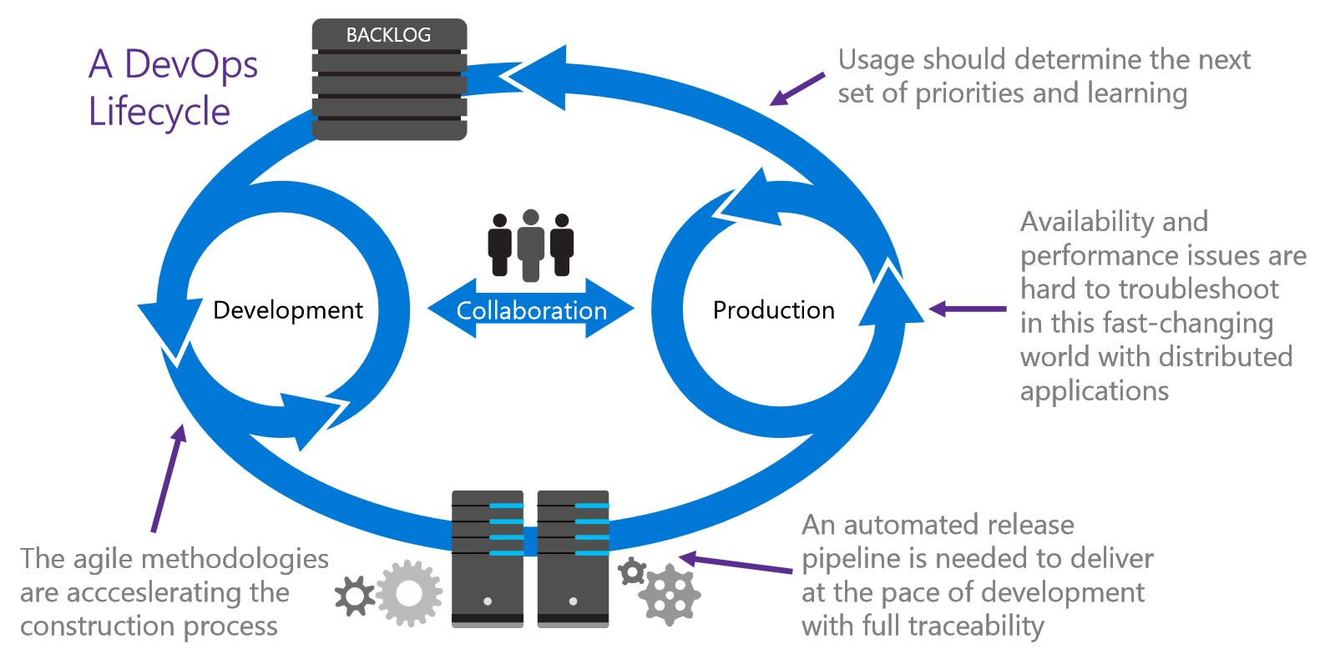
Production telemetry drives the backlog
Creating Telemetry
Notes:
https://www.visualstudio.com/learn/journey-cloud-cadence-lessons-learned-microsoft-developer-division/
A tacit assumption of Agile was that the Product Owner was omniscient and could groom the backlog correctly. In contrast, when you run a high-reliability service, you can observe how customers are actually using its capabilities in near real-time. You can release frequently, experiment with improvements, measure, and ask customers how they perceive the changes. The data you collect becomes the basis for the next set of improvements you do. In this way, a DevOps product backlog is really a set of hypotheses that become experiments in the running software and allow a cycle of continuous feedback. DevOps grew from Agile based on four trends:
It isn’t just about failing fast (i.e. throwing poor quality out there because you will fail fast and fix it), it is around hypothesis testing and getting feedback. With poor quality, the feedback on the hypothesis is compromised.

Slide 36
Application Logging Telemetry
Creating Telemetry
Every feature should be instrumented
Different levels of logging exist
Choose right level of logging is very important. Remember, Warnings != Errors
Debug
Info
Warn
Error
Fatal
Health & Availability
Delays
Authentication/Authorization
Data Changes
Resources (RAM, disk, CPU…)
System & Data Access
Faults & Errors
Invalid Input (malicious injection…)
Start ups & Shut downs
Backups success/failure

Slide 37
Examples of Telemetry metrics / levels
Creating Telemetry
Business level Data
Application level Data
Infrastructure level Data
Client software level Data
Deployment pipeline level Data
#sales transactions, revenue of sales transactions, user signups, churn rate, A/B testing results,…
Transaction times, user response times, application faults,…
Database, OS, networking, storage,…
Web server traffic, CPU load, disk usage,…
Application Errors, Crashes,…
Build Pipeline status (red/green/amber), change deployment lead times, test environment promotions, environment status
Reliance of anecdotal evidence reduces the effectiveness of continuous improvements efforts – Gartner
Use Data Facts instead of Rumors, Blame,…

Slide 38
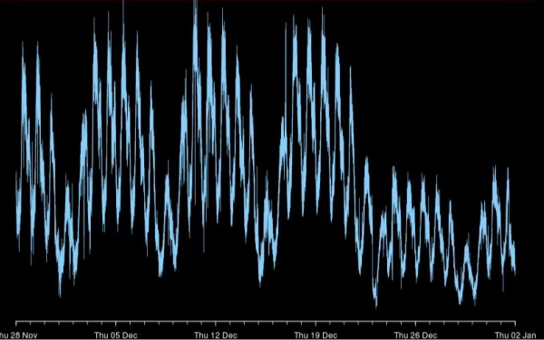
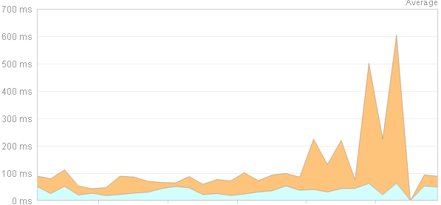
Infrastructure metrics
Creating Telemetry
Is infrastructure a contributing cause of a problem we’ve detected?
Graphing Business metric alongside Infrastructure & Application metrics is key
“Customer signup drops significantly”
*
Business metric
Why?
+
“Database queries are taking much longer”
Infrastructure metric
Resolve
Notes:
* Source: Dr. Toufic Boubez, “Simple math for anomaly detection”

Slide 39
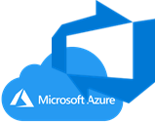
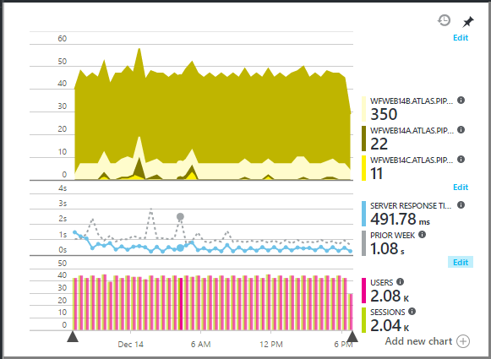
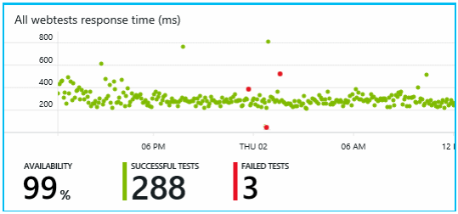

Azure Application Insights
Creating Telemetry
Extensible analytics platform that monitors the performance and usage of your live web applications on Azure
Monitors your live application to help you detect and diagnose performance issues and exceptions
Helps you discover how your app is used

Slide 40
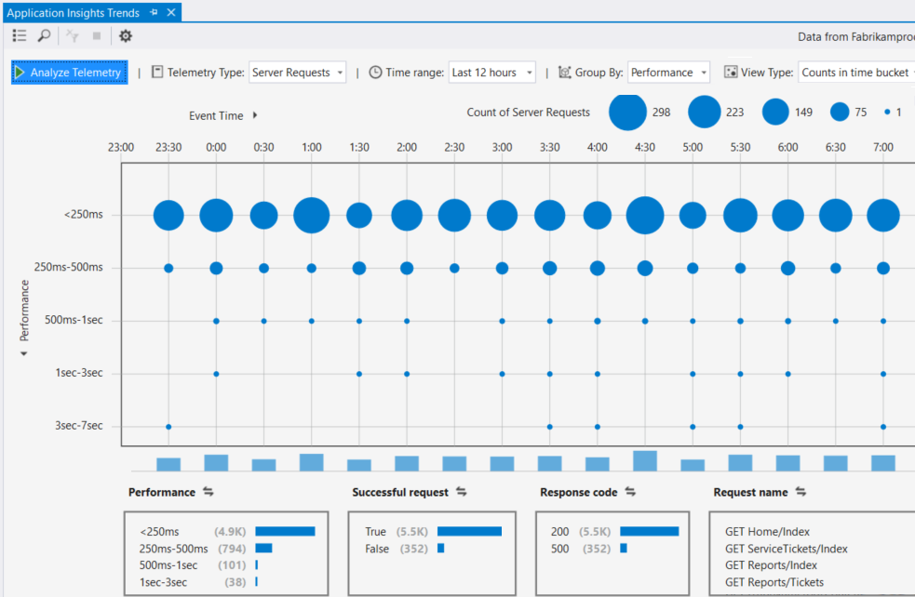
Application Insights – What does it monitor?
Creating Telemetry
Request rates, response times, and failure rates
Exceptions
Page Views and Load Performance
AJAX calls
Performance Counters

Slide 41
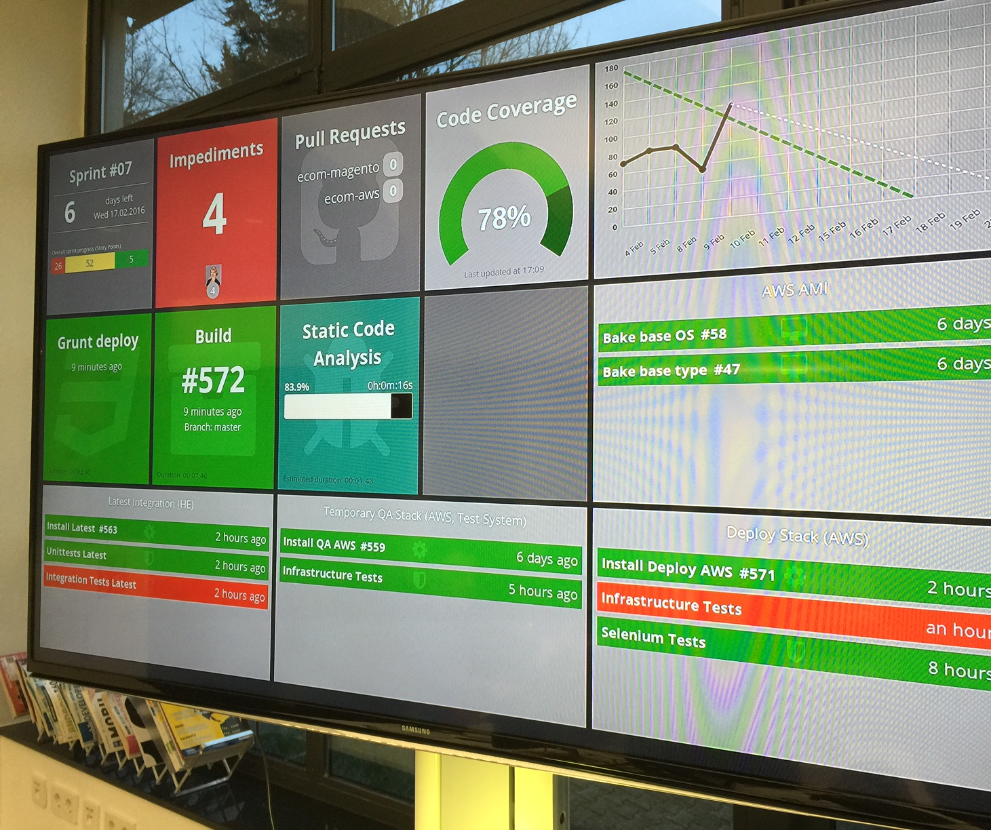
Information Radiators
Analyze Telemetry & Provide Feedback
Telemetry should be highly visible
Allows absolute transparency to everyone
Promotes responsibility among team members
Nothing to hide from customers & stakeholders
Nothing to hide from themselves

Slide 42
Capture Web Application Logs with App Service Diagnostics Logging
What are app logs?
App logs are the output of runtime trace statements in app code
Example:
Check some logic in your code by adding a trace to show when a particular function is being processed
Example:
Only see a logged message when a particular level of error has occurred
Caution:
Excessive logs can carry a performance hit and quickly consume storage
Types of logging available:
Depends on the code framework of the app, and on whether the app is running on a Windows or Linux app host.
More info (link):
Enable and configure App Service application logging - Learn | Microsoft Docs
Notes:
Reference:
https://docs.microsoft.com/en-us/learn/modules/capture-application-logs-app-service/

Slide 43
Exercise - Enable and configure App Service application logging using the Azure portal - Learn | Microsoft Docs
https://docs.microsoft.com/en-us/learn/modules/capture-application-logs-app-service/3-enable-and-configure-app-service-application-logging-using-the-azure-portal

Slide 44
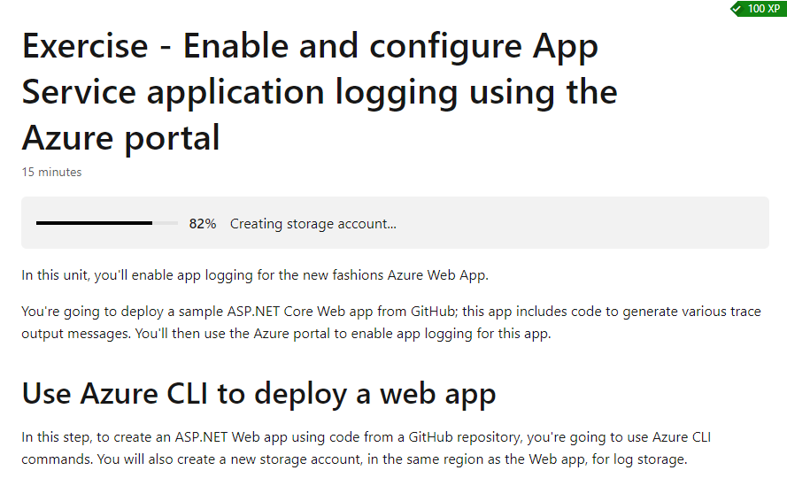

Slide 45
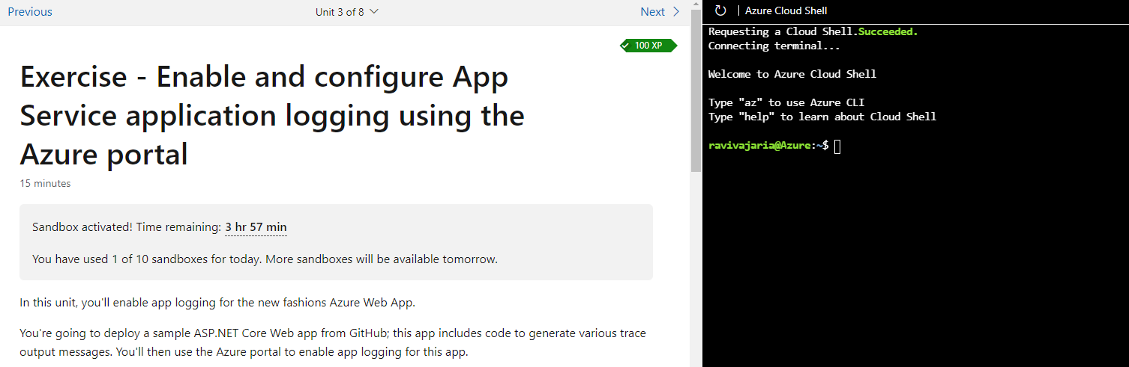

Slide 46
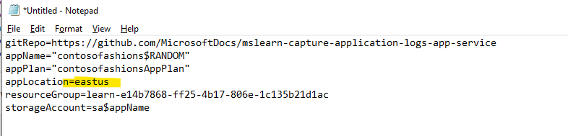

Slide 47
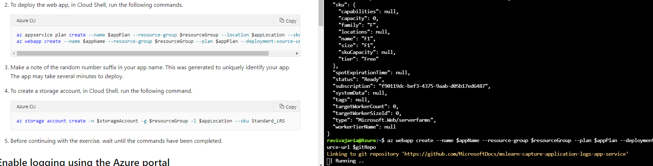

Slide 48
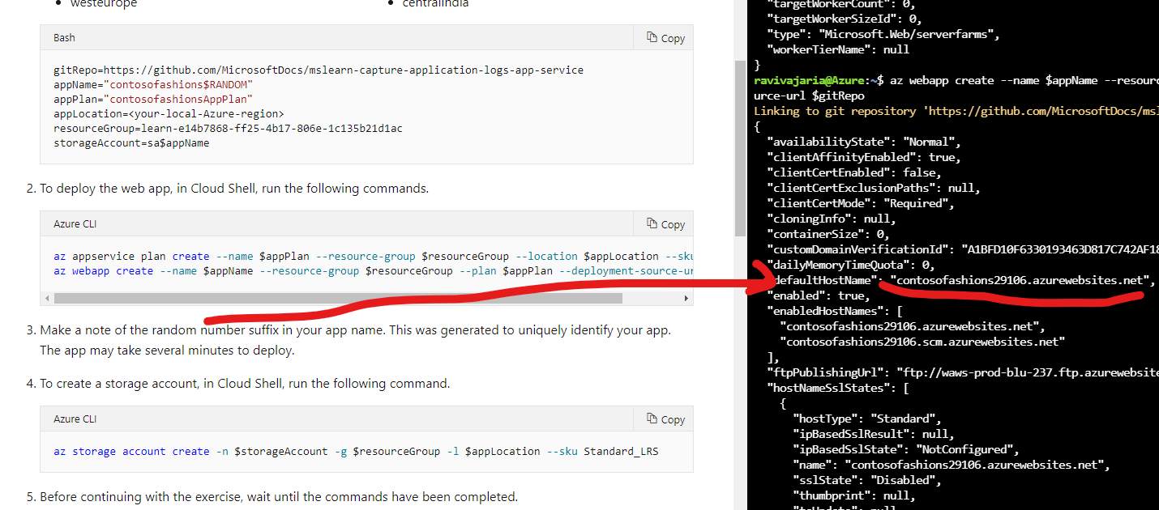
Copy URL in notepad

Slide 49
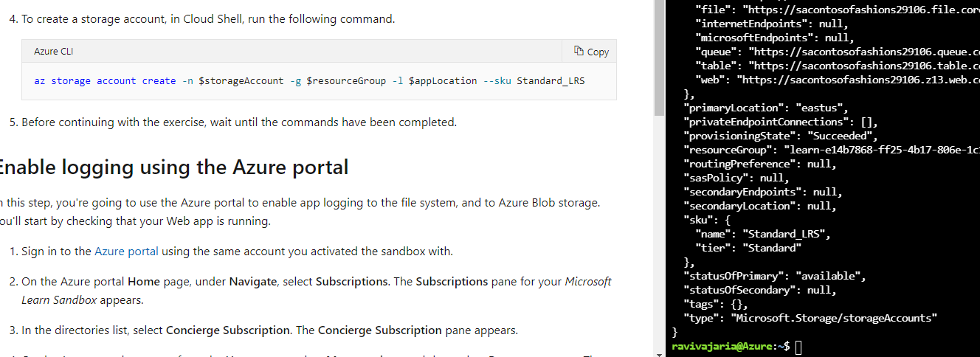
Create storage account

Slide 50
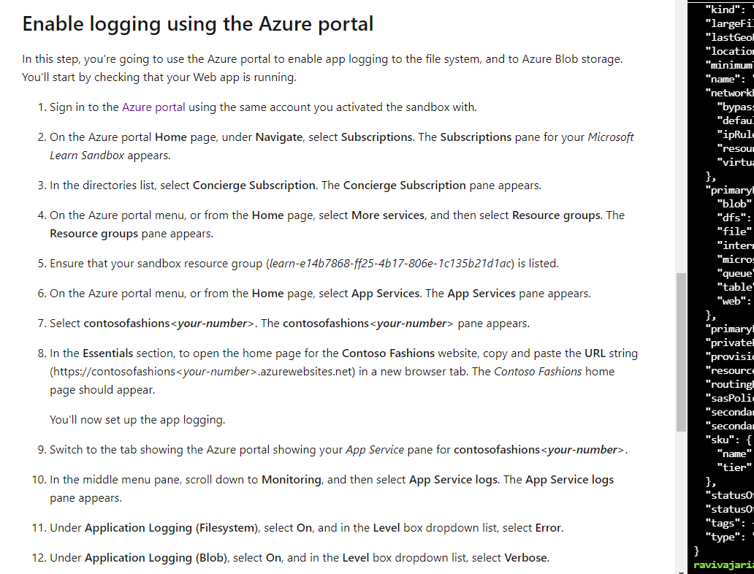
Enable logging using Azure Portal

Slide 51
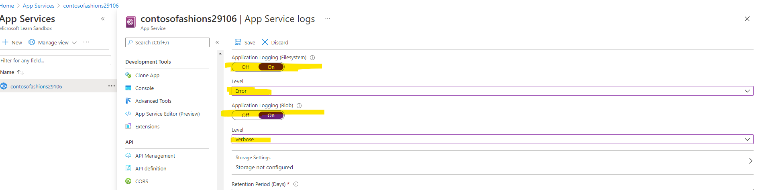

Slide 52
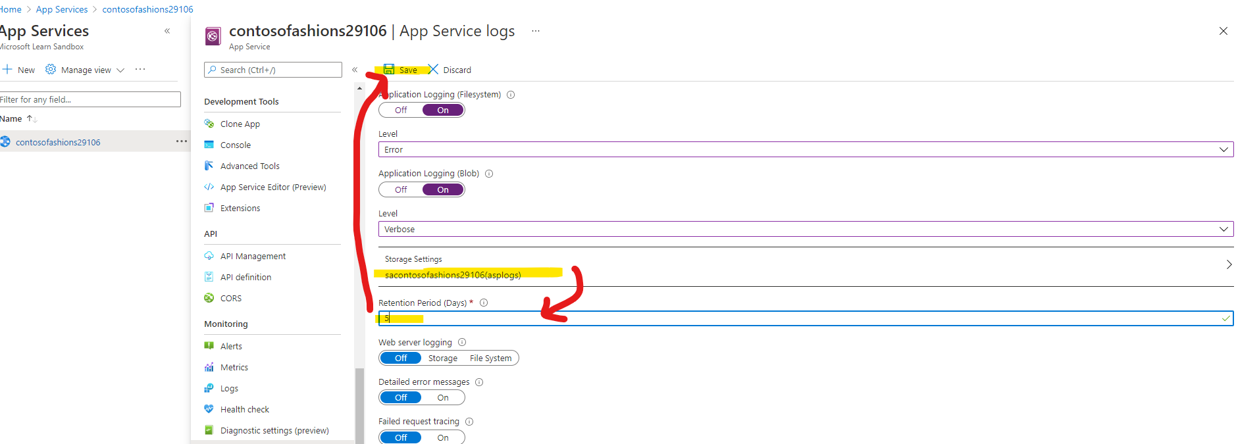

Slide 53
View live application logging with the log streaming service
Live log streaming is an easy and efficient way to view live logs for troubleshooting purposes
It is designed to provide a quick view of all messages that are being sent to the app logs in the file system, without having to go through the process of locating and opening these logs
To use live logging, you connect to the live log service from the command line and can then see text being written to the app's logs in real time.
It is good tool for initial debugging. Log messages show in real time to give you quick feedback on code or server issues. You can then make a change, redeploy your app, and instantly see the results.
The live log stream connects to only one app instance, so is not useful if you have a multi-instance app. Live logging is also of limited use as you scale up your apps. In these scenarios, it is better to ensure that messages are saved to log files that can be opened and studied offline.
Notes:
Reference:
https://docs.microsoft.com/en-us/learn/modules/capture-application-logs-app-service/4-view-live-application-logging-activity-with-the-log-streaming-service

Slide 54
Exercise - View live application logging with the log streaming service using Azure CLI
https://docs.microsoft.com/en-us/learn/modules/capture-application-logs-app-service/5-view-live-application-logging-activity-with-the-log-streaming-service-using-azure-cli

Slide 55
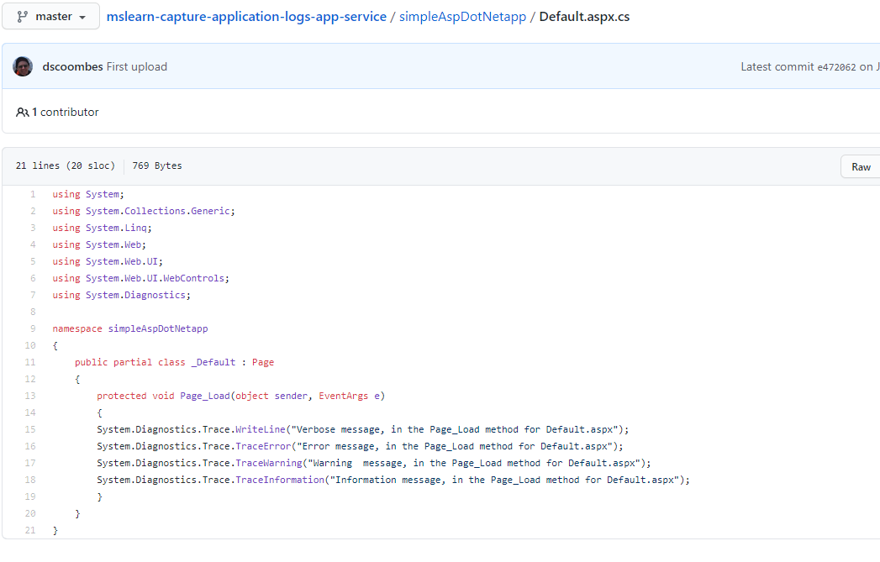
Application Code
https://github.com/MicrosoftDocs/mslearn-capture-application-logs-app-service
Each time a page is loaded, a log entry will be generated for every log level that has been enabled in the app service. So, because you enabled Error-level logging for the file system, you will only see LogError and LogCritical messages.

Slide 56
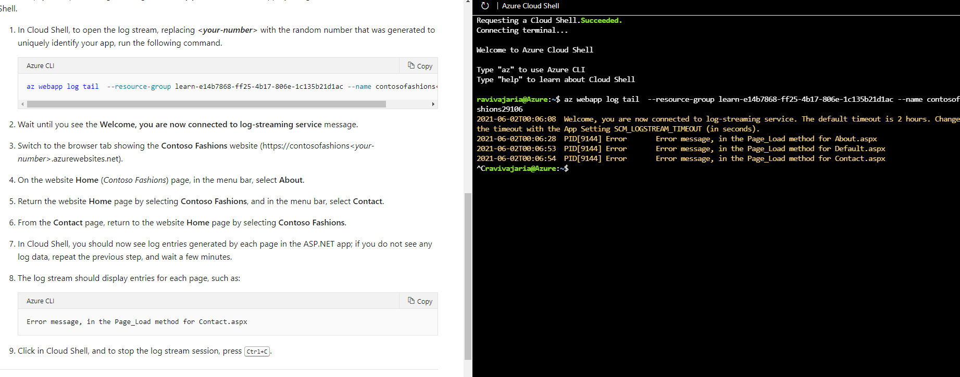
Open the log stream generated by your ASP.NET Web app by using Azure CLI commands from Cloud Shell.

Slide 57
Retrieve application log files
Log files are a great resource for a Web developer, but only if you know how to find and use the logged information. Here, you'll look at the methods you can use to retrieve logged information, ready for offline analysis.
Log file storage locations
Windows app log files
For Windows apps, file system log files are stored in a virtual drive that is associated with your Web App. This drive is addressable as D:\Home, and includes a LogFiles folder; within this folder are one or more subfolders:
Application - Contains application-generated messages, if File System application logging has been enabled.
DetailedErrors - Contains detailed Web server error logs, if Detailed error messages have been enabled.
http - Contains IIS-level logs, if Web server logging has been enabled.
W3SVC<number> - Contains details of all failed http requests, if Failed request tracing has been enabled.
Notes:
References:
https://docs.microsoft.com/en-us/learn/modules/capture-application-logs-app-service/6-retrieve-application-log-files-from-an-application

Slide 58
Methods for retrieving log files
Azure CLI
Kudu
Notes:
References:
https://docs.microsoft.com/en-us/learn/modules/capture-application-logs-app-service/6-retrieve-application-log-files-from-an-application

Slide 59
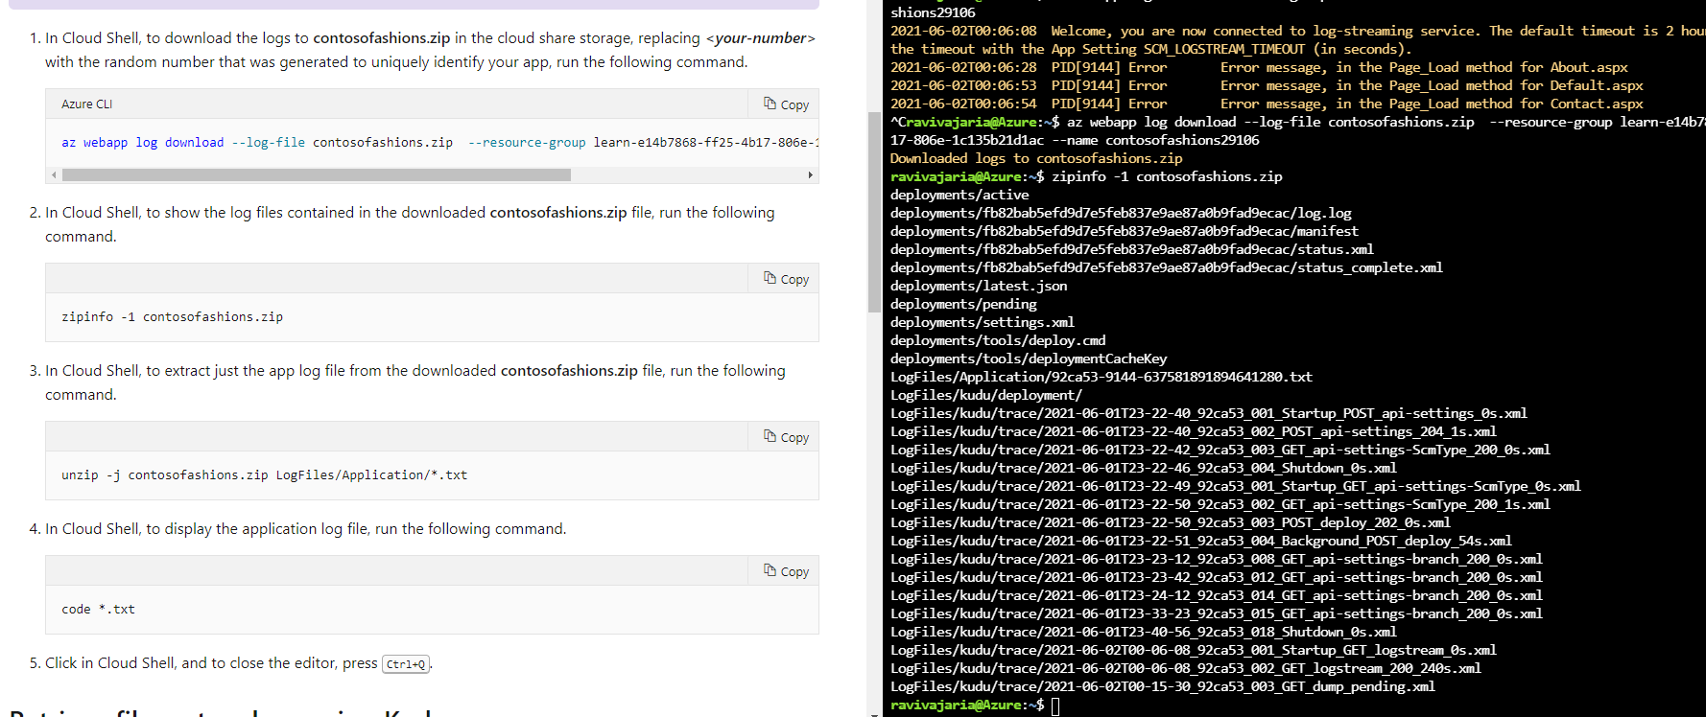
Retrieve file system logs using Azure CLI
Notes:
Reference:
https://docs.microsoft.com/en-us/learn/modules/capture-application-logs-app-service/7-retrieve-application-log-files-from-an-application-using-azure-cli-and-kudu

Slide 60
Retrieve file system logs using Kudu; Search logs saved in Azure Blob Storage
Follow steps in this learning module to 1) use Kudu 2) Search in Azure Blob Storage
Exercise - Retrieve Application Log Files using Azure CLI and Kudu - Learn | Microsoft Docs
Notes:
https://docs.microsoft.com/en-us/learn/modules/capture-application-logs-app-service/7-retrieve-application-log-files-from-an-application-using-azure-cli-and-kudu

Slide 61
Capture and view page load times in your Azure web app with Application Insights
Application Insights is a feature of Azure Monitor, is an extensible Application Performance Management (APM) service for developers and DevOps professionals.
It monitors live web applications and you can enable it for many Azure App Service web apps without modifying any of the app's code.
Let’s instrument an app to learn how we can diagnose and fix performance problems by:
Enabling Application Insights for an Azure web app without changing its source code
Using Application Insights to capture information about page load times
Notes:
References:
https://docs.microsoft.com/en-us/learn/modules/capture-page-load-times-application-insights/

Slide 62
Application Insights resources
Application Insights is represented in Azure as a resource deployed your subscription
Each Application Insights resource is a repository for application telemetry data
It includes the various displays and configuration tools to view from the Azure portal
To send telemetry data to an Application Insights resource from an app, we need to configure the app with the instrumentation key of the Application Insights resource
Once the (Application Insights) resource starts to receive telemetry data, you can use the Azure portal to explore and analyze it
Notes:
References:
https://docs.microsoft.com/en-us/learn/modules/instrument-web-app-code-with-application-insights/

Slide 63
Runtime instrumentation and build-time instrumentation
Two ways to configure your app to send data to Application Insights
Runtime instrumentation
Build-time instrumentation
Notes:
References:
https://docs.microsoft.com/en-us/learn/modules/instrument-web-app-code-with-application-insights/

Slide 64

Runtime instrumentation
Captures telemetry without requiring you to change the web app's source code
Can be enabled from Azure portal while creating web app first time or anytime afterwards
Use this method to set up Application Insights without involving developers or when code management policies prevent you from changing the app's source code
Note that some advanced data displays aren't available when you use only runtime instrumentation.
Notes:
References:
https://docs.microsoft.com/en-us/learn/modules/instrument-web-app-code-with-application-insights/

Slide 65

Build-time instrumentation
Developers add a server-side SDK to the web app's code
For example, in an ASP.NET Core app, a developer could reference a NuGet package to access the SDK
Instrumenting app with the Application Insights SDK enables full functionality and the richest set of visualizations in Application Insights
It also enables adding custom events and telemetry to code to monitor unusual or unique behavior
Notes:
References:
https://docs.microsoft.com/en-us/learn/modules/instrument-web-app-code-with-application-insights/

Slide 66
Client-side instrumentation
Can be enabled for an app by including a standard Application Insights JavaScript library in pages delivered to your app's users
Captures information about the user experience of the app, including page load times, details of browser exceptions, and performance data about AJAX calls
Azure App Service web apps can be configured to automatically inject the client SDK and capture many client-side metrics
JavaScript code can be added by development to capture data about specific events
Client-side instrumentation enables displays like usage analysis
Notes:
References:
https://docs.microsoft.com/en-us/learn/modules/instrument-web-app-code-with-application-insights/

Slide 67
Enabling runtime instrumentation – Web App Requirements
Supported only on Windows web apps. Relies on capabilities of IIS
Use of Application Insights in Linux apps is fully supported but requires to modify application code to reference the Application Insights SDK
Any Windows App Service web app can benefit but those created with the ASP.NET or ASP.NET Core frameworks have the best integration with Application Insights. They automatically record framework-specific data, like stack traces and dependency information, in Application Insights

Slide 68
Enabling automatic client-side telemetry
To automatically inject the JavaScript SDK and necessary configuration into pages served by your web app, add a new application setting named APPINSIGHTS_JAVASCRIPT_ENABLED and set the value to true.

Slide 69
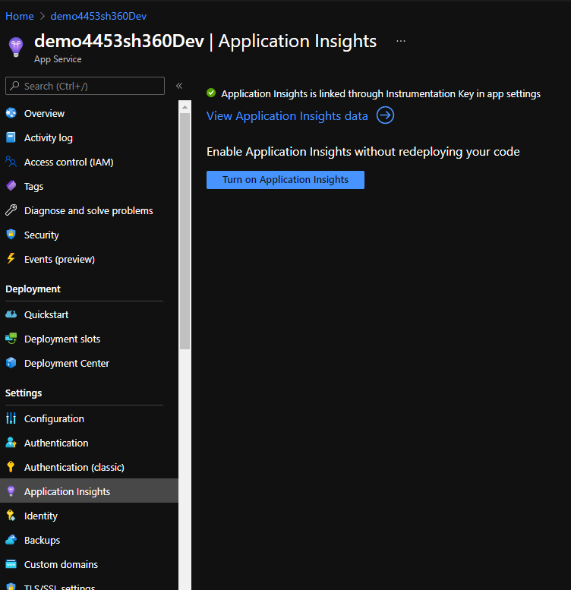
Enable Application Insights for the Web App
Select the Web App
Under Settings, select Application Insights
If not enabled, click Turn on Application Insights

Slide 70
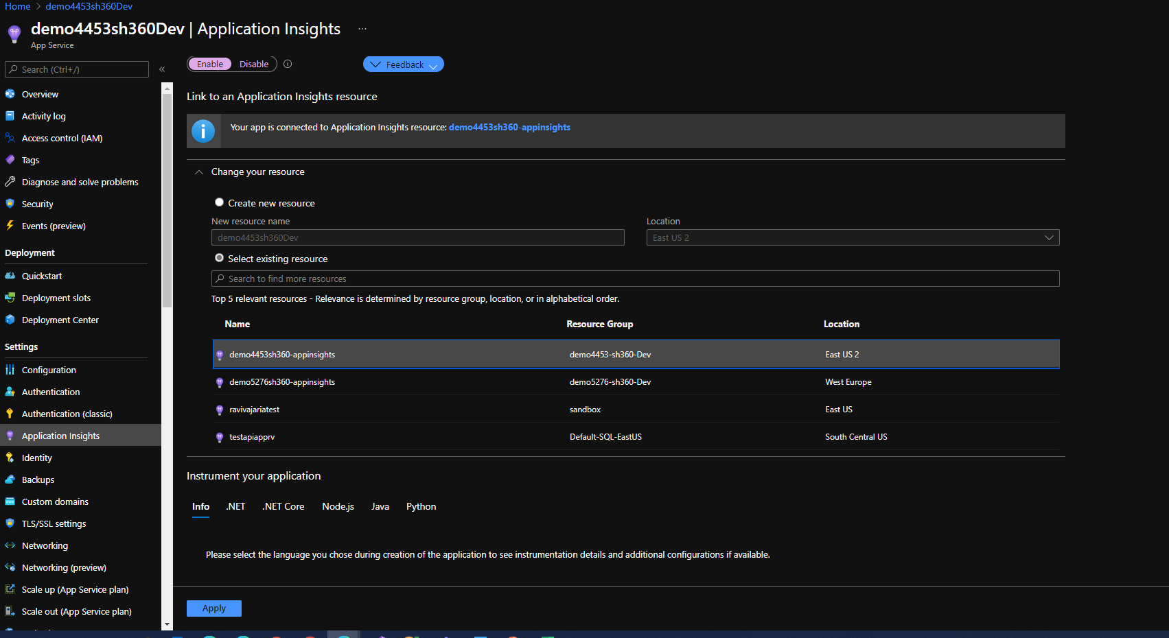
Enable Application Insights for the Web App
Make sure Enabled is selected.
Then create new or select existing App Insights resource,
Click Apply

Slide 71
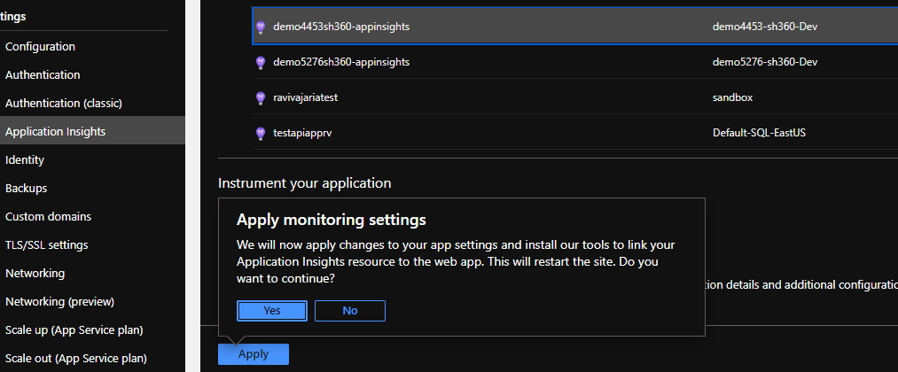
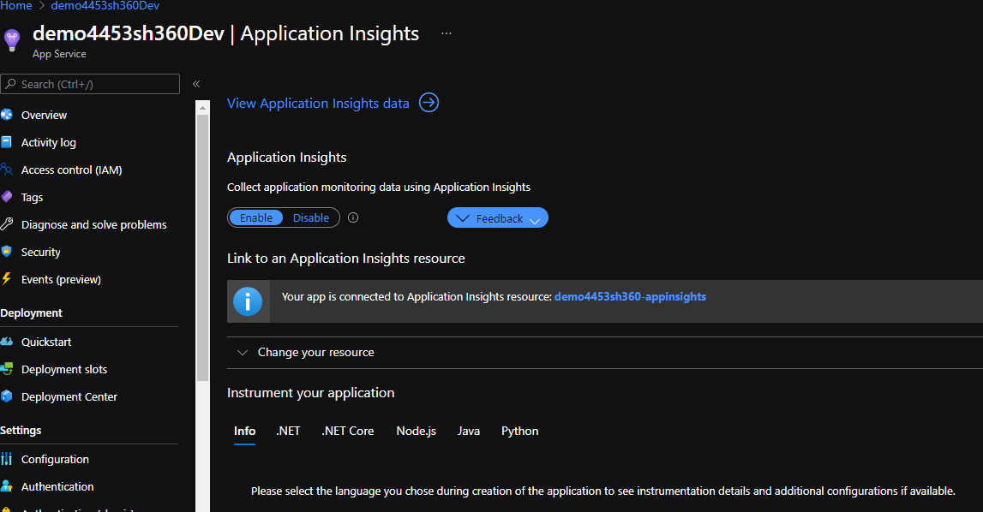
Enable Application Insights for the Web App
Click Yes

Slide 72
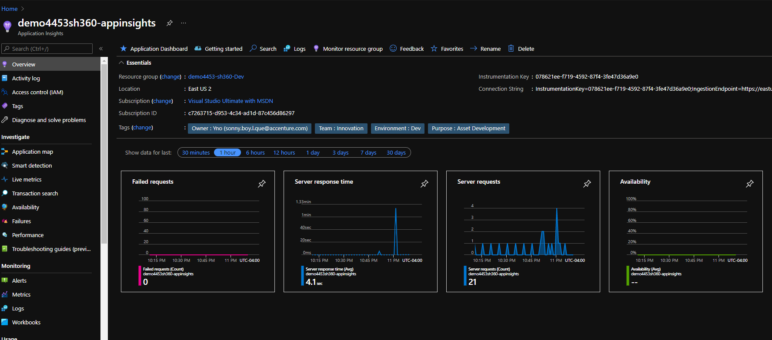
Enable Application Insights for the Web App
View data such as server requests

Slide 73
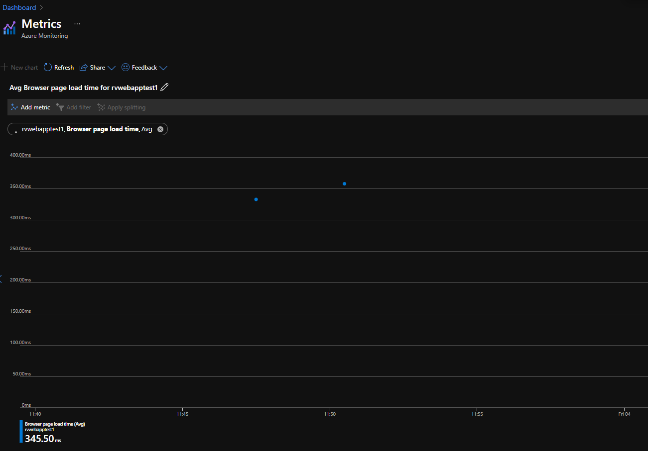
Enable Application Insights for the Web App
Demo to show page load time:
For SmartHotel360 demo, enable App Insights OR
Create a new Windows Web App based on .Net Core 2.1 with new app insights resource
Using Kudu console, add Default.html with text “This is a test”
Add configuration setting APPINSIGHTS_JAVASCRIPT_ENABLED with value true
Restart app
Load page a few times
Go to App Insights → Metrics and select page load time
Notes:
Reference:
https://docs.microsoft.com/en-us/learn/modules/capture-page-load-times-application-insights/3-exercise-enable-application-insights

Slide 74
Instrument server-side web application code with Application Insights
The Application Insights SDK can be used in web app's code to track custom events and metrics, and automatically capture detailed telemetry about performance and behavior.
For example:
How often do users watch a video to its end, and how often do they interrupt it in the middle?
How often do they choose to Like a video?
Notes:
Reference:
https://docs.microsoft.com/en-us/learn/modules/instrument-web-app-code-with-application-insights/

Slide 75
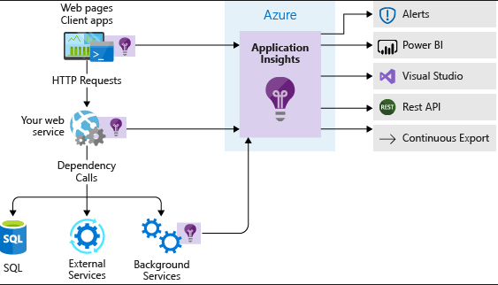
Application Insights SDK
Is a software package you reference and use in your application's code
Hooks into the web application framework that powers your app and automatically captures detailed runtime information. For example,
Data about HTTP requests, system metrics, service dependencies, and exceptions
Also allows adding code to record information about events and metrics that are specific to the business domain of your app
Sends this telemetry data to an Application Insights resource in Azure. The Application Insights service processes and aggregates the data into a form that's easy to query and visualize
Notes:
Reference:
https://docs.microsoft.com/en-us/learn/modules/instrument-web-app-code-with-application-insights/
https://docs.microsoft.com/en-us/learn/modules/instrument-web-app-code-with-application-insights/2-install-application-insights-sdk

Slide 76
Value / Benefit of the SDK
Not limited to the apps that are deployed to Azure
Comprehensive data collection
Custom telemetry
Advanced features
Local telemetry in Visual Studio
Runtime instrumentation doesn't offer deep insight into your app the way the SDK can
Runtime instrumentation is also an Azure-specific feature and is available only for Windows-based web apps
The SDK can be used to instrument any application, service, or component running anywhere
Notes:
Reference:
https://docs.microsoft.com/en-us/learn/modules/instrument-web-app-code-with-application-insights/
https://docs.microsoft.com/en-us/learn/modules/instrument-web-app-code-with-application-insights/2-install-application-insights-sdk
Comprehensive data collection: Data like user retention, unique users, and unique sessions is available in Application Insights only when you use the Application Insights SDK.
Custom telemetry: With the SDK, you can add code to your application to capture events and metrics that are specific to your app and its business domain.
Advanced features: Some Application Insights features are available only when you use the SDK. For example, Live Metrics Stream lets you watch and drill down into metrics in real time.
Local telemetry in Visual Studio: Telemetry data from applications instrumented with the SDK can be viewed locally in Visual Studio when you run the app in the debugger.

Slide 77
Install Application Insights SDK
Open
Open the solution in Visual Studio
Install
Install NuGet Package Microsoft.ApplicationInsights.AspNetCore
Initialize
Initialize the Application Insights SDK by calling UseApplicationInsights method in startup.cs in ConfigureServices() function

Slide 78
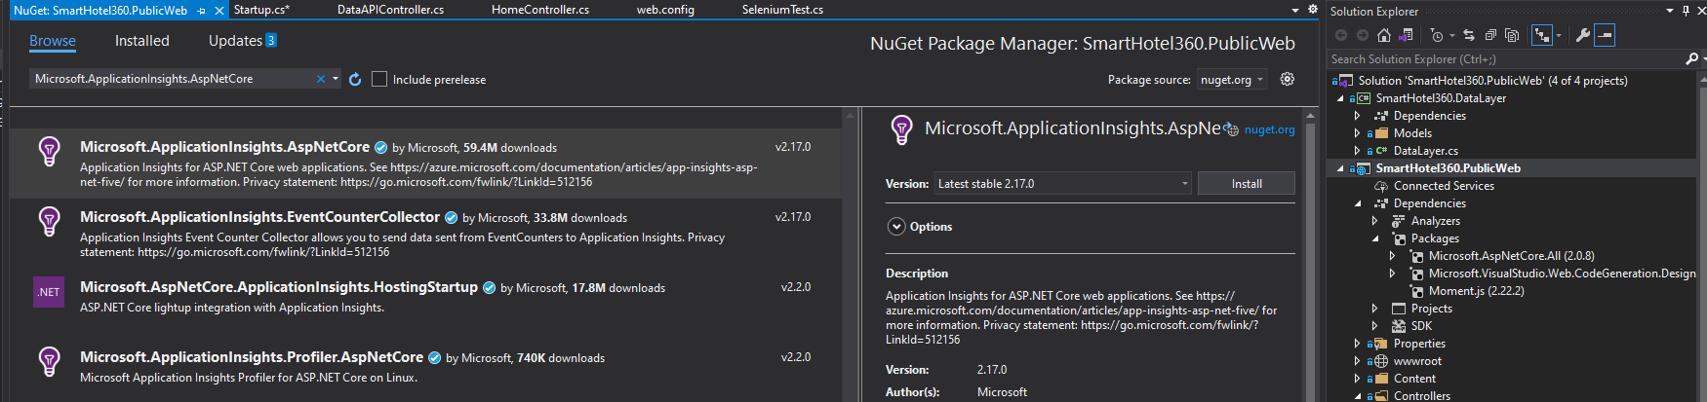
Install Package
Notes:
Reference:
https://docs.microsoft.com/en-us/learn/modules/instrument-web-app-code-with-application-insights/

Slide 79
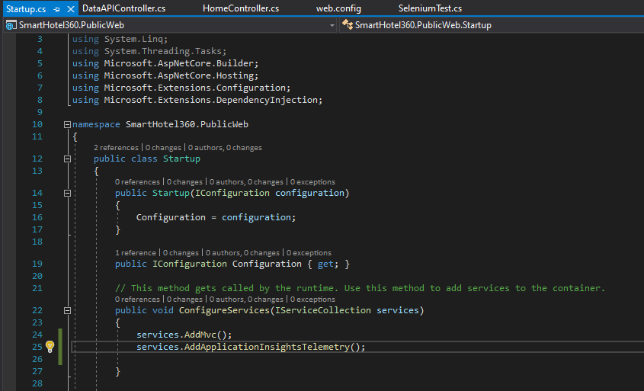
Initialize the Application Insights SDK
Notes:
Reference:
https://docs.microsoft.com/en-us/learn/modules/instrument-web-app-code-with-application-insights/

Slide 80
Confirm the Application Insights configuration
See the value of APPINSIGHTS_INSTRUMENTATIONKEY in app configuration settings. When the app runs in App Service, this value will be available as an environment variable, and the Application Insights SDK will use it as configuration.
Verify instrumentation key for the Application Insights resource it is same as one shown in app’s settings.
Notes:
Reference:
https://docs.microsoft.com/en-us/learn/modules/instrument-web-app-code-with-application-insights/
https://docs.microsoft.com/en-us/learn/modules/instrument-web-app-code-with-application-insights/3-exercise-install-application-insights-sdk

Slide 81
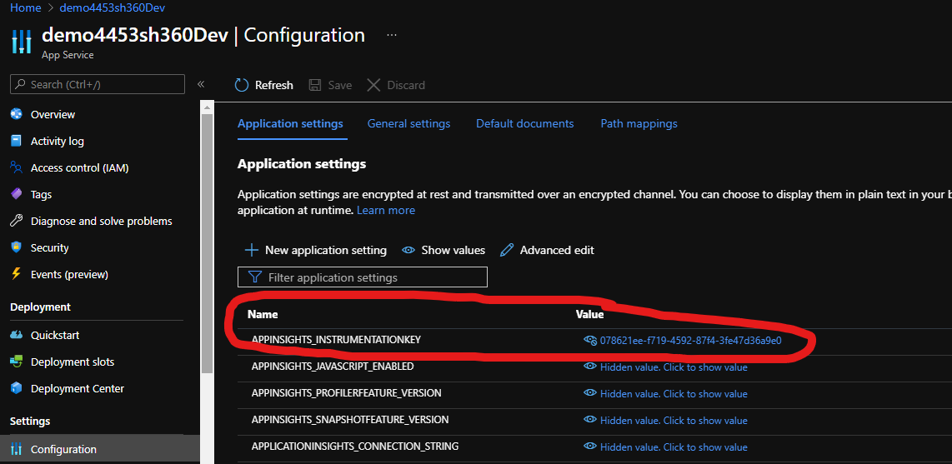
See the value of APPINSIGHTS_INSTRUMENTATIONKEY
Notes:
Reference:
https://docs.microsoft.com/en-us/learn/modules/instrument-web-app-code-with-application-insights/
https://docs.microsoft.com/en-us/learn/modules/instrument-web-app-code-with-application-insights/3-exercise-install-application-insights-sdk

Slide 82
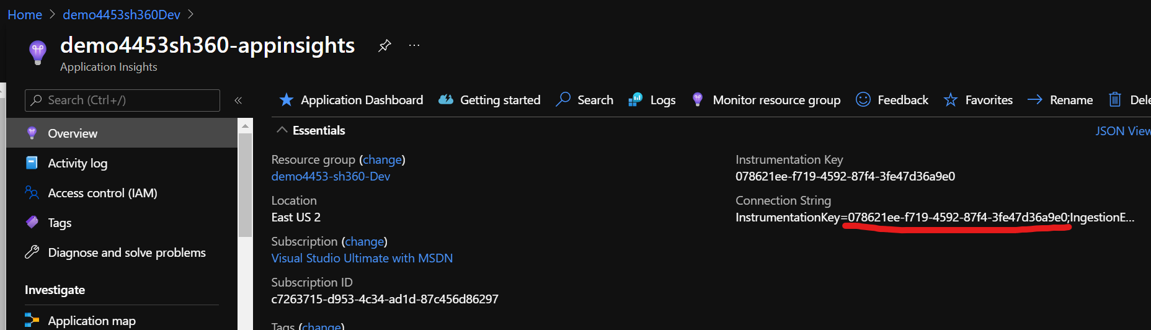
Verify instrumentation key for the Application Insights resource
Notes:
Reference:
https://docs.microsoft.com/en-us/learn/modules/instrument-web-app-code-with-application-insights/
https://docs.microsoft.com/en-us/learn/modules/instrument-web-app-code-with-application-insights/3-exercise-install-application-insights-sdk

Slide 83
Instrument the application
Decide which event / user action needs to be tracked
Instantiate the TelemetryClient object
TrackEvent
Deploy code change and generate telemetry data
View information in Azure portal
Demo
Exercise - Install the Application Insights SDK - Learn | Microsoft Docs
Exercise - Instrument the application - Learn | Microsoft Docs
Notes:
~30 mins
Reference:
https://docs.microsoft.com/en-us/learn/modules/instrument-web-app-code-with-application-insights/

Slide 84
Acquisition Funnel
Creating Telemetry
Feature Teams define their goals in an acquisition funnel
Are features used by customers in their daily work/activities?
Every business metric should be actionable
How to change/evolve product & be amenable to experimentation and A/B testing
Instrumentation & analysis of metrics is part of our daily work
Helps Product Owners describe business context of each feature

Slide 85
Instill a “culture of causality”
Creating Telemetry
A very common scenario…
Production Outage
Reboot Server
Reboot Server Next to it
Reboot All Servers
Blame Developers
Poor performers use undisciplined approach & blindly reboot servers
Continually create Telemetry
Disciplined approach to solve problems & provide confidence
Notes:
* Kevin Behr, Gene Kim & George Spafford coined the term “culture of causality” in The Visible Ops Handbook

Slide 86
The need for centralized telemetry infrastructure
Creating Telemetry
Production/ Pre-Production Services & Environnements
Deployment Pipeline
Data Collection
at
Business Logic, Application & Environment layers
Logs, Events, Metrics
Centralized
+
Event Router
for
Storage, Visualization, Trending & Alerting
Transform logs into metrics
Statistical Analysis operations
Anomaly detection
Self-Service entry & retrieval
Monitoring is so important it should be more available
& scalable than the systems being monitored – Adrian Cockroft
Notes:
* According to Adrian Cockroft

Slide 87
Telemetry analysis techniques
Analyze Telemetry & Provide Feedback
Use statistical techniques to discover variances and ever-weaker failure signals hidden in telemetry data and alert (automated)
Means & Standard deviation
Is metric significantly different from its norm? (used with bell curve distribution)
Fast Fourier, Smoothing, Kolmogorov-Smirnov (K-S filter)
Find differences/similarities in periodic/seasonal metric data (used with non-bell curve distribution)
*
*
Something wrong, but
not alerted
K-S filter detects drop
in traffic & alerts
Without K-S filter, only
2 alerts triggered
With K-S filter, additional
alert triggered
Notes:
Source: Dr. Toufic Boubez, “Simple math for anomaly detection”
K-S test: https://en.wikipedia.org/wiki/Kolmogorov%E2%80%93Smirnov_test

Slide 88
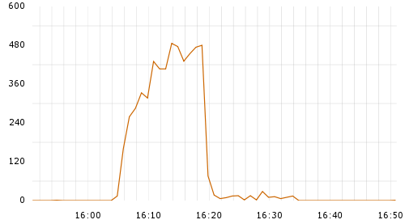
Use Telemetry to make deployment safer
Analyze Telemetry & Provide Feedback
Fact: Production Deployments main cause of Production issues
Rely on production metrics to detect errors and quickly restore service
Resolve using feature toggles, fix forward or roll-back techniques
Deployment causes
run-time errors
Fix deployed into
Production 8 minutes later

Slide 89

The dangers of change control processes
Create Review and Coordination Processes to increase quality of work
Enable Development and Operations to reduce risk of production changes before they are made
Counter intuitive: “strict change and testing controls potentially contribute to deployment failures”*
Too many questions on change request form
Too many authorizations needed
Too long lead times for approval process
Too long manual testing
Increased friction in deployment process
Increased batch sizes
Increased deployment lead times
Result in
Focus on Peer Reviews culture
(as key control practice e.g. Pull Requests*)
*
Reduce reliance on external bodies to authorize changes
Notes:
* Gene Kim after talking to John Allspaw and Jez Humble about the Knight Capital accident

Slide 90
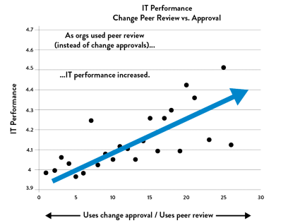
Change Peer Review vs Approval
Create Review and Coordination Processes to increase quality of work
Organizations that rely on peer review outperform those with change approvals*
Use Change Approval processes
Use Peer Review approach
Notes:
* Source: Puppet Labs , State of DevOps Report 2014

Slide 91
Instil peer review culture in our daily work
Create Review and Coordination Processes to increase quality of work
Everyone must have a peer review with someone
Pair Programming* & TDD
“Over-the-shoulder”
Email pass-around
Tool-assisted (code) peer review
Everyone monitors everyone else during commit stream
Qualify high risk changes & arrange SME review
Avoid large changes
Break them up
Notes:
* Dr. Laurie Williams performed a study in 2001 that showed “paired programmers are 15% slower than two independent individual programmers, while ‘error-free’ code increased from 70% to 85%.

